Slide 1

CS 533 INTRO TO DATA SCIENCE
Michael Ekstrand

Slide 2
CLASSIFYING TEXT

Slide 3

Learning Outcomes
Use vector-space representations to classify texts
Classify into more than 2 classes
Photo from United Nations COVID-19 Response on Unsplash

Slide 4
Classifying Text
We want to classify texts
Spam and not-spam
Identify news categories
Separate news from opinion
Identify fraud
Input: term vectors

Slide 5
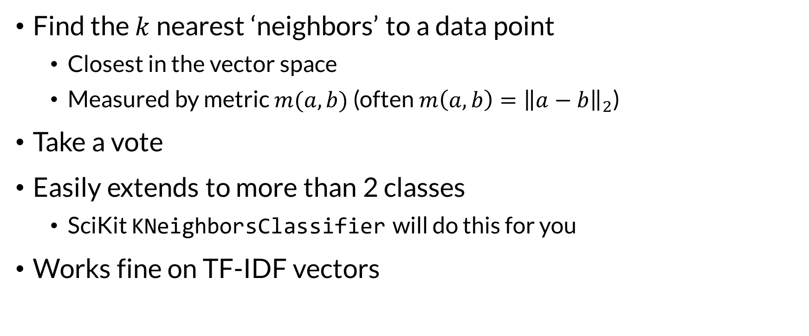
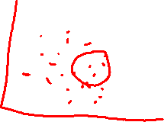
K-NN Classifier
Find the $k$ nearest ‘neighbors’ to a data point
Closest in the vector space
Measured by metric $m(a,b)$ (often $m\left(a,b\right)={\left\|a−b\right\|}_{2}$)
Take a vote
Easily extends to more than 2 classes
SciKit KNeighborsClassifier will do this for you
Works fine on TF-IDF vectors

Slide 6
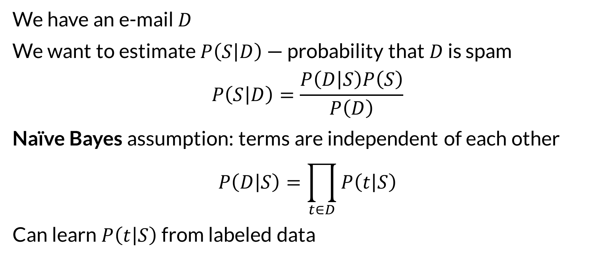

Naïve Bayes Classifier
We have an e-mail $D$
We want to estimate $P\left(S | D\right)$ — probability that $D$ is spam
$$P\left(S | D\right)=\frac{P\left(D | S\right)P\left(S\right)}{P\left(D\right)}$$
Naïve Bayes assumption: terms are independent of each other
$$P\left(D | S\right)=\prod_{t∈D}{P\left(t | S\right)}$$
Can learn $P\left(t | S\right)$ from labeled data

Slide 7
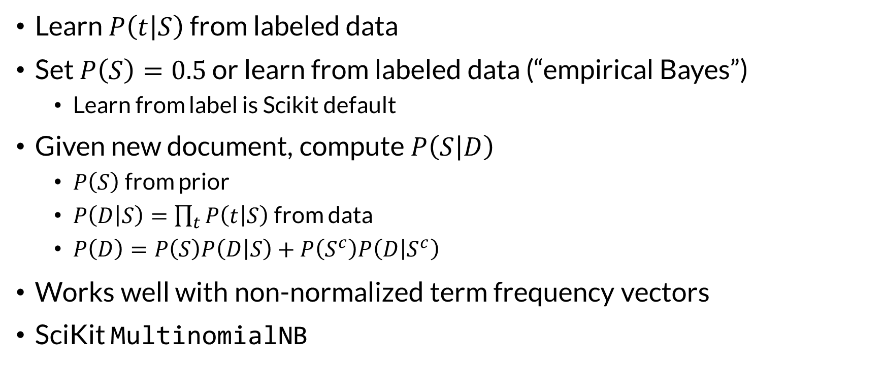
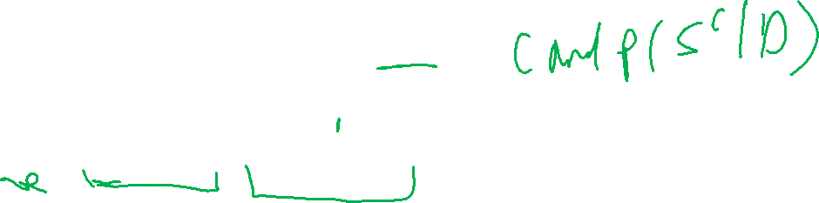
Naïve Bayes
Learn $P\left(t | S\right)$ from labeled data
Set $P\left(S\right)=0.5$ or learn from labeled data (“empirical Bayes”)
Learn from label is Scikit default
Given new document, compute $P\left(S | D\right)$
$P\left(S\right)$ from prior
$P\left(D | S\right)=\prod_{t}{P\left(t | S\right)}$ from data
$P\left(D\right)=P\left(S\right)P\left(D | S\right)+P\left(S^{c}\right)P\left(D | S^{c}\right)$
Works well with non-normalized term frequency vectors
SciKit MultinomialNB

Slide 8

Wrapping Up
K-NN and Naïve Bayes can predict multiple classes from vector data, such as term frequency vectors from text.
Spam filter example notebook demonstrates naïve Bayes.
Photo by Elijah Hail on Unsplash

